Slide 1
Internal Review Helper Bot
December 2022

Slide 2
Agenda
Bot Pre-Requisites
Running the Bot
Exceptions

Slide 3
Bot Pre-Requisites
(One Time Set Up)

Slide 4
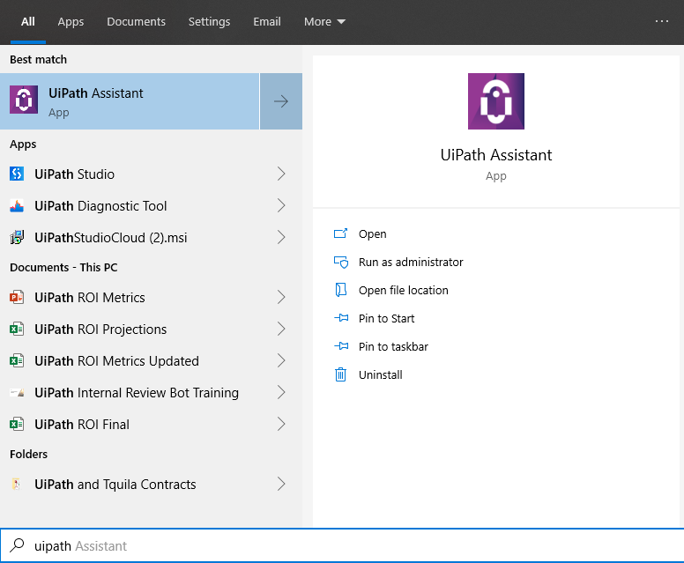
One Time Set Up
Confirm that you have UiPath Studio and UiPath Assistant on your computer. You should see them when you search for UiPath
If not, log an IT ticket asking to install the UiPath applications

Slide 5
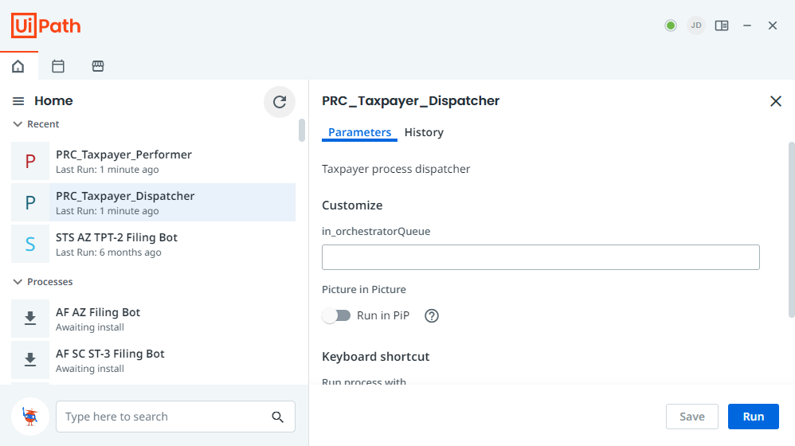
One Time Set Up
When you open Assistant, you should see a green circle in the top right, as well as the Bot: PRC_Performer. Click on it to install it.

Slide 6
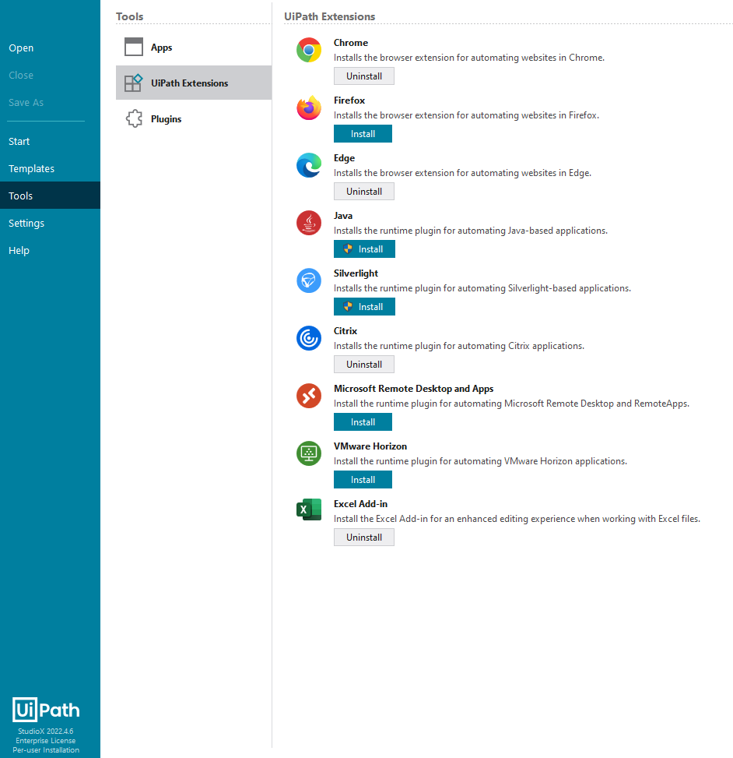
One Time Set Up
When you open Studio, you should see (at least) version 2022 4.6
Go to Tools and you should see the Citrix extension installed
If the extension is not installed, you can install it but will need Admin credentials and an IT ticket

Slide 7
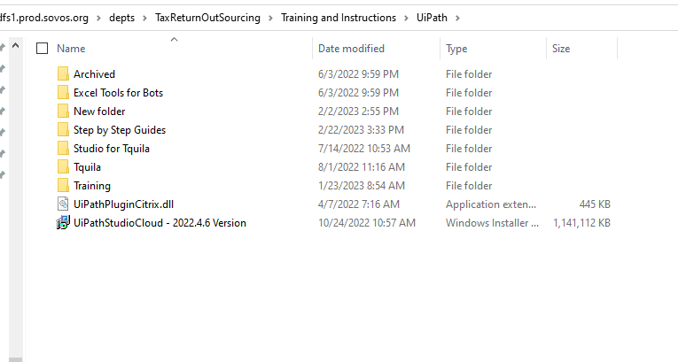
One Time Set Up
If you need to install the newer version of Studio, you can find the installer at this file location:
\\somproddfs1.prod.sovos.org\depts\TaxReturnOutSourcing\Training and Instructions\UiPath
Make sure you select the most recent version of Studio, copy it to your desktop, and then install it
You will need Admin credentials

Slide 8
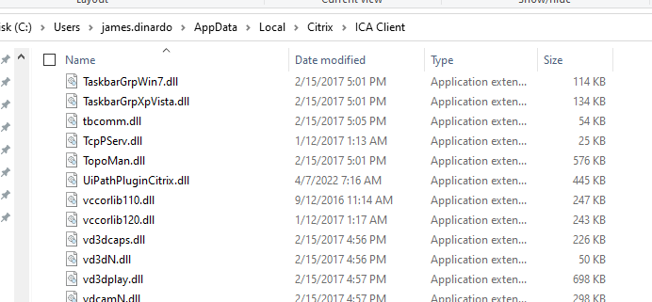
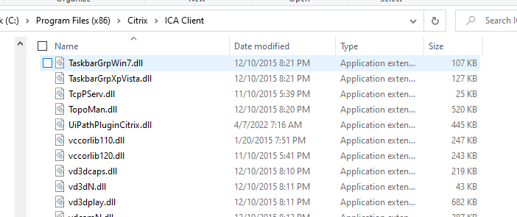
One Time Set Up
Confirm that the UiPathPluginCitrix.dll is present in your Local App Data
If not, copy the file from:
C:\Program Files (x86)\Citrix\ICA Client
To:
C:\Users\james.dinardo\AppData\Local\Citrix\ICA Client
- May need to turn on hidden items in file explorer
Notes:
If you do not see the Local App data folder, you can copy it from ICA Client to the correct location
You can copy the ICA Client folder to the Local App Data if it is not yet there

Slide 9
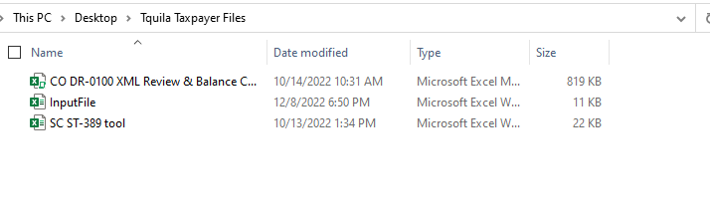
One Time Set Up
Create your own, Local folder on your desktop for the three input files: InputFile, CO Balancing Tool, and SC Tool
These files should be provided, but if you need them, then please reach out to the UiPath Development Team

Slide 10
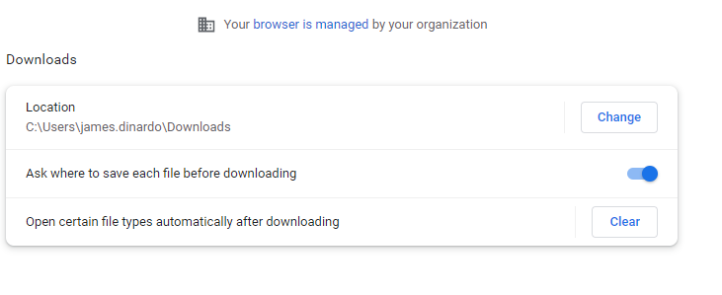
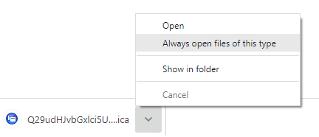
One Time Set Up
Update your Chrome Settings to ask where to save each file before downloading
Ensure you can open Citrix/Taxsolver in Chrome. Right click the download to always open

Slide 11
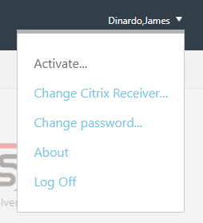
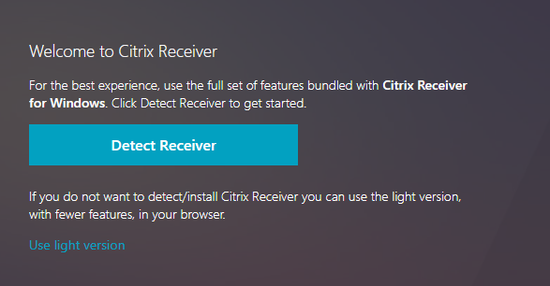
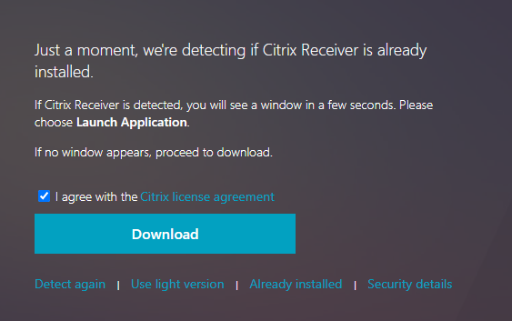
One Time Set Up
If you need to set up Taxsolver in Chrome:
Log into Citrix via Chrome
When on the page to select your TS Instance: Click your name in the top right
Click Change Citrix Receiver
Click Detect Receiver
Click Already Installed
Try Opening an Instance in TS

Slide 12
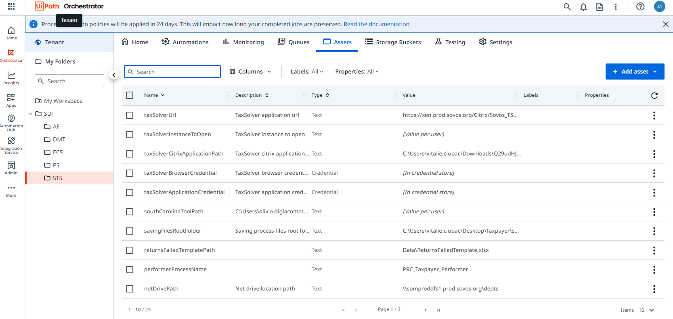
One Time Set Up
Next, you will need to update Assets for the Bot.
To update an Asset, navigate to cloud.uipath.com > Orchestrator > SUT Folder > STS Folder > Assets
The list of Required Assets to update are on the next slides

Slide 13
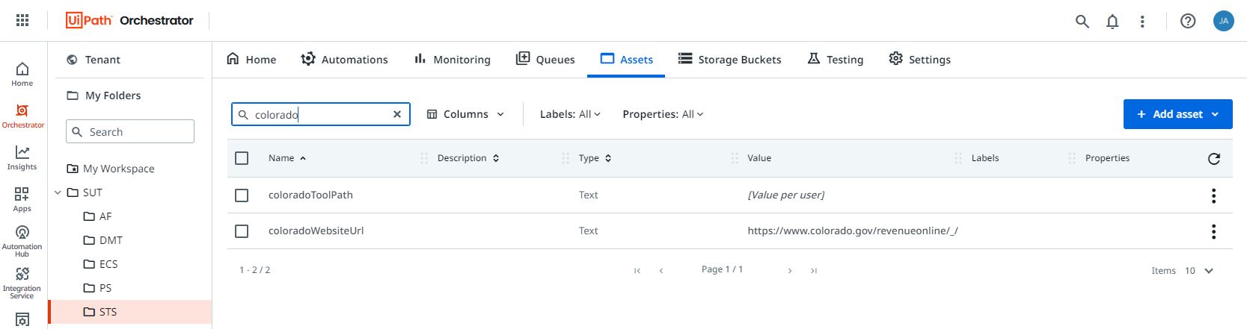
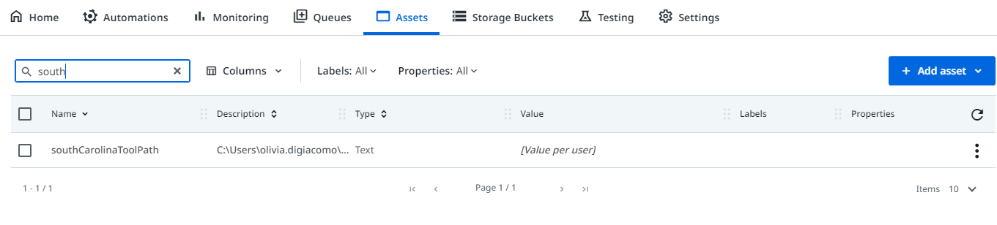
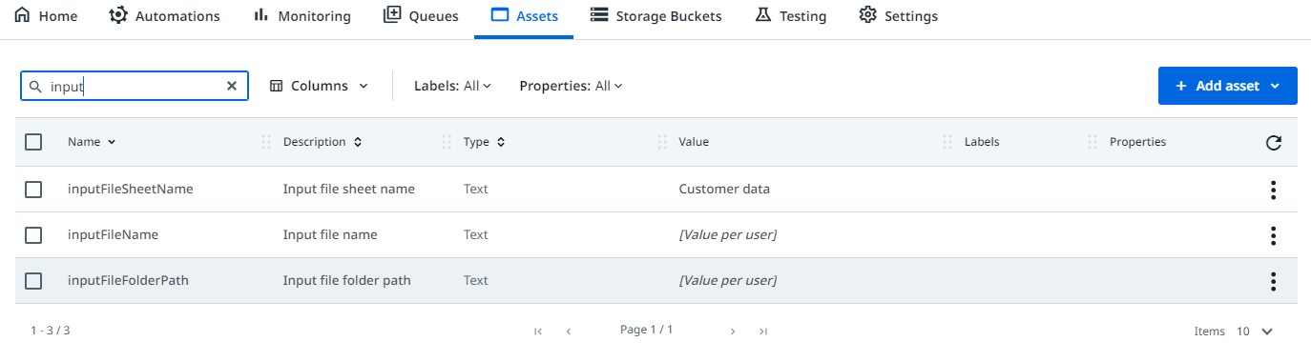
One Time Set Up
Update the Assets for the files in Orchestrator. You will need to update three Assets for the files you just saved in the folder on your desktop.
On the Asset screen, search for:
coloradoToolPath
southCarolinaToolPath
inputFileFolderPath

Slide 14
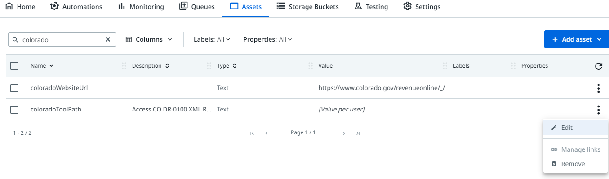
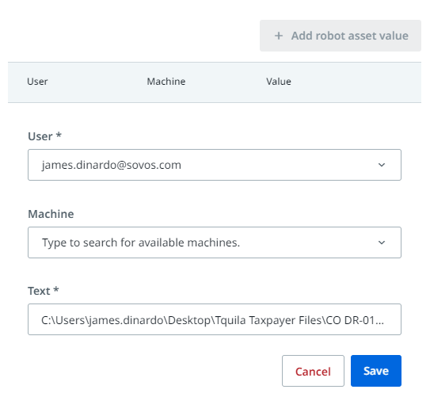
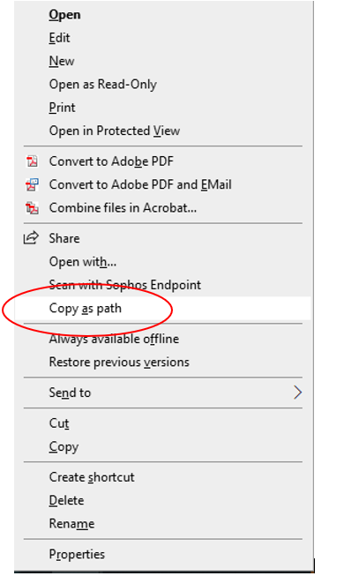
One Time Set Up
To update each Asset, click on the three dots, then edit
Once in the Asset, click on Add Robot Asset Value
Search for your username, and then input the link into the Text field
Copy the file as a Path for the CO and SC Balancing Tools
You can copy/paste just the file path for the Input File
If you cannot see Copy as Path, then hold down Shift and then right click on the file
Remove quotation marks from the file path when you copy and paste it in
Notes:
Remove quotation marks from the file path when you copy and paste it in

Slide 15
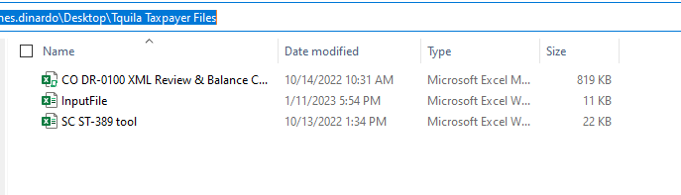
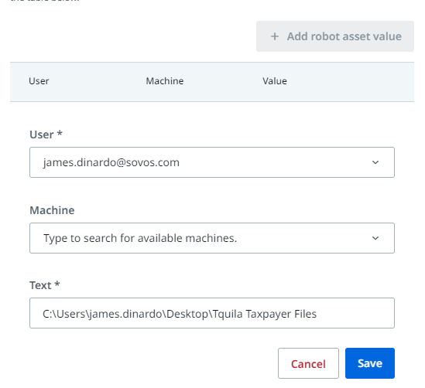
One Time Set Up
You only need to copy/paste the URL from your file explorer for the Input File Asset
Just the URL that is highlighted in the top right screenshot
You will need to copy the CO and SC tools as a Path

Slide 16

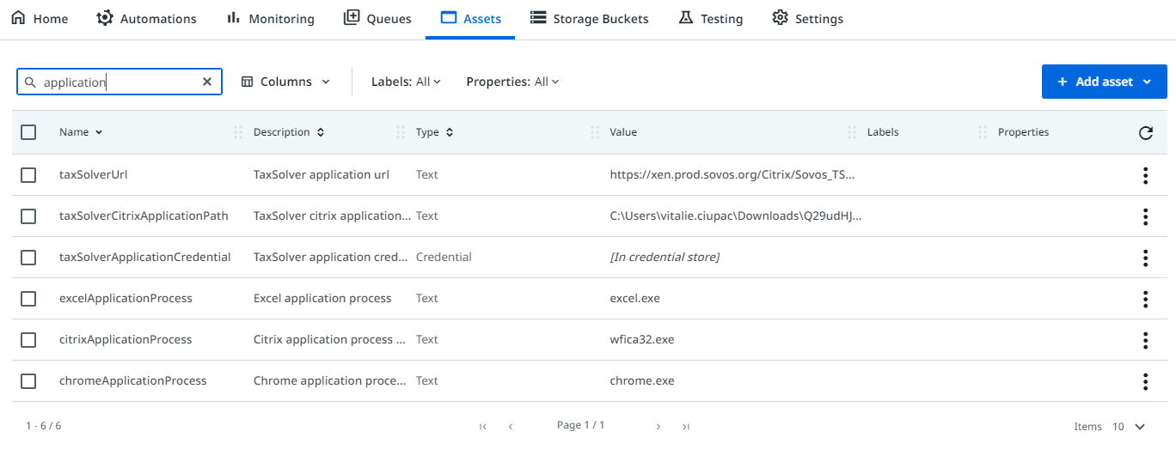
One Time Set Up
Next, you will need to update the Assets for Citrix and Taxsolver
You will need to update the following Assets:
taxSolverBrowserCredential
taxSolverApplicationCredential

Slide 17
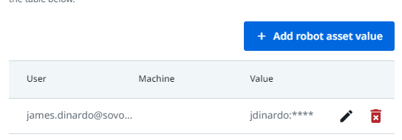
One Time Set Up
Follow the same steps to update these Assets
Browser Credentials are for your Citrix login information
Application Credentials are for your Taxsolver login information
Anytime these passwords change, you will need to update here
Make sure you update the InputFileFolderPath, not the File Folder Name

Slide 18
Running the Bot

Slide 19
Prepare the Bot
The following steps need to be set up every time before you run the bot
Future state of the bot will improve upon this process
High level: you will need to set up Taxsolver, create a new Review folder, copy the TFR to the new folder, and sort the Current Period Returns list by return name on the TFR from A-Z, and then input the Client Name into the input file
Make sure the TFR and Input File are saved and closed before running the bot
Don’t open the returns failed file while the bot is running
The bot will email the Returns Failed file to the email you put into the Input File

Slide 20
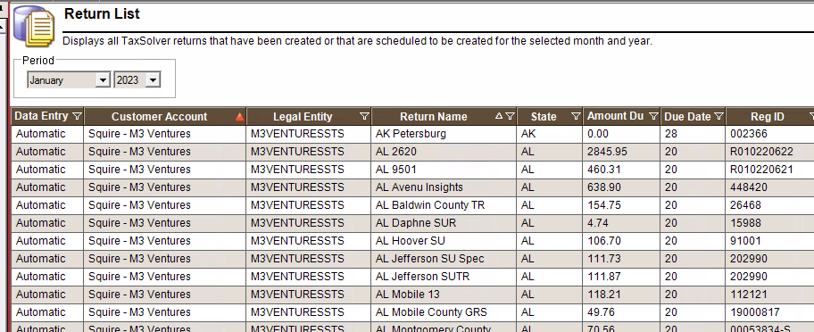
Prepare the Bot
Open Taxsolver
Filter Taxsolver for the specific Customer Account
Then filter for the necessary Workflow – Review, File Return, and Filed
Sort by Return Name A-Z

Slide 21
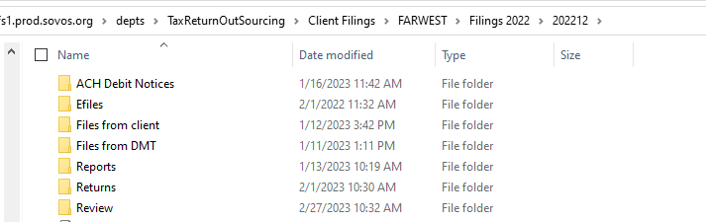
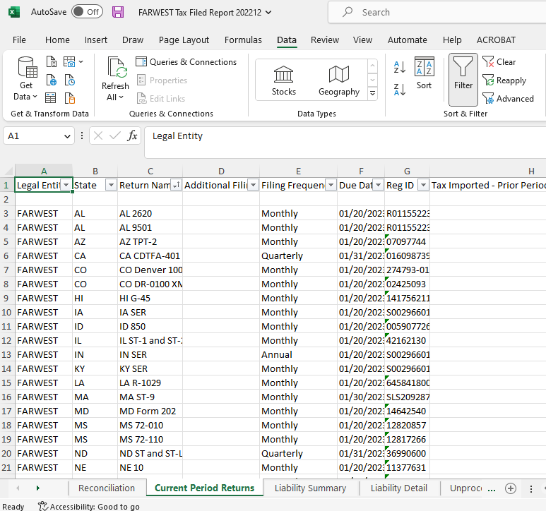
Prepare the Bot
Go to the Client’s filing folder and create a new folder called Review
Save a copy of the Tax Filed Report to this new folder
Add a filter and sort the Current Period Returns tab
There will be an empty line in the second row

Slide 22
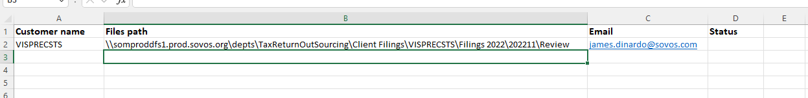
Prepare the Bot
Open the Input File and input the name of the client into the Customer Name as it appears in the Taxsolver Customer Account column
Then copy the file path of the new Review Folder to the Input File

Slide 23
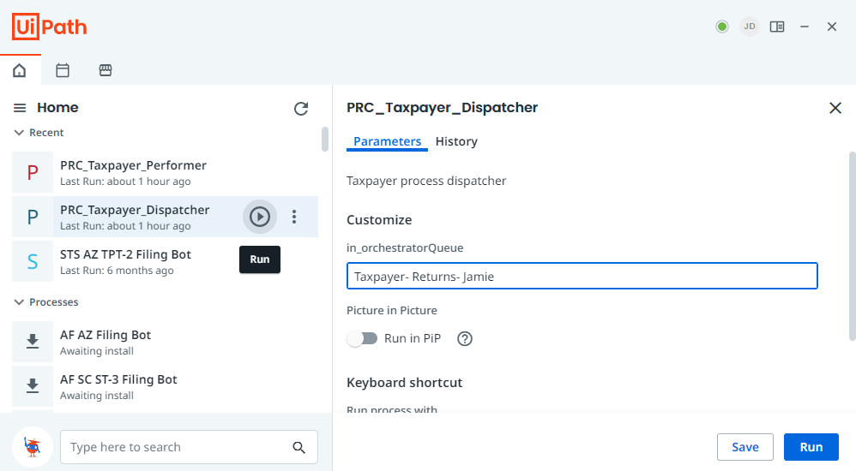
Run the Bot!
Open Assistant and press play on the Performer!

Slide 24
Notes

Slide 25
Notes
The Bot currently reviews returns for Other Deductions, Balancing states, and Gross sales matching on Local/State returns
The Bot checks the TFR for the imported data matching to what is on the return
There is a threshold for states that typically have slight differences
You should still run a Filing Calendar report and check the returns for any Relevant Filing Calendar notes
The bot will take control of your mouse and keyboard while running
The bot outputs the returns failed in a folder with the current date
The bot will email you a copy of the Returns Failed spreadsheet once it is done
Notes:
You should still check the IR notes as well

Slide 26
Future Updates
Automatically select the TFR without manual input
Build the entire review sheet with the RDR, TFR, and DMT Files
Input multiple clients into the input sheet and have it run through a list of clients at once
Run a Filing Calendar Report to flag relevant FC notes
Prepayments – review PP tracker,

